Slide 1
Priority Queues
Computer Science, Purdue University
Copyright WILEY, Goodrich and Tamassia, Data Structures And Algorithms

Slide 2
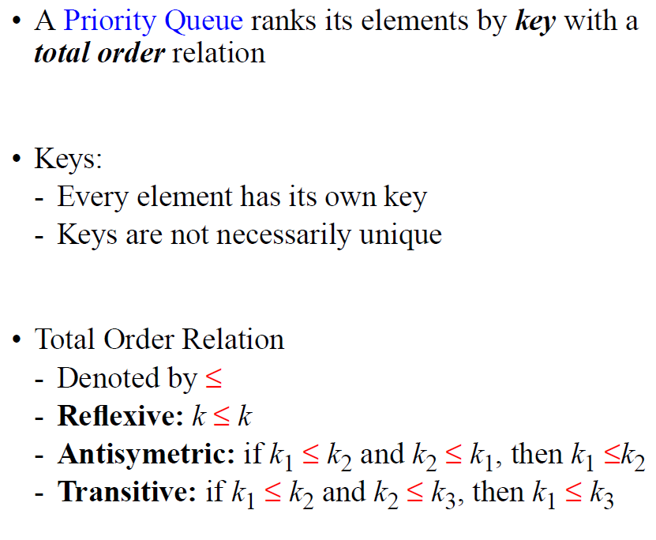
Priority Queues
Introduction
Computer Science, Purdue University

Slide 3
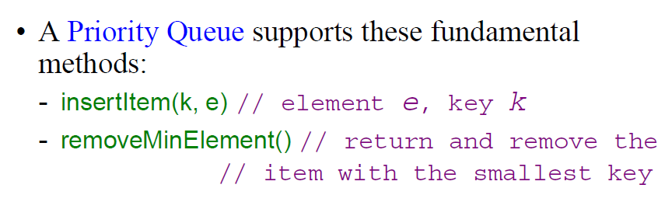
Priority Queues
Introduction
Computer Science, Purdue University

Slide 4
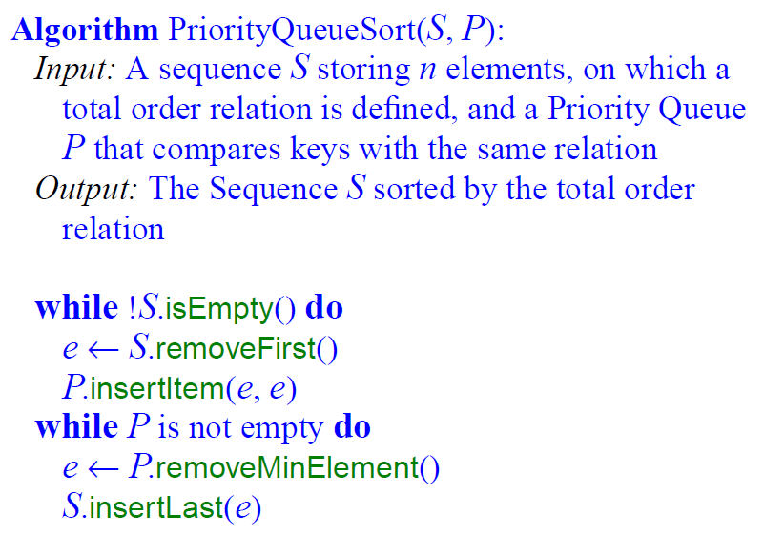
Priority Queues
Sorting Using Priority Queues
Computer Science, Purdue University

Slide 5
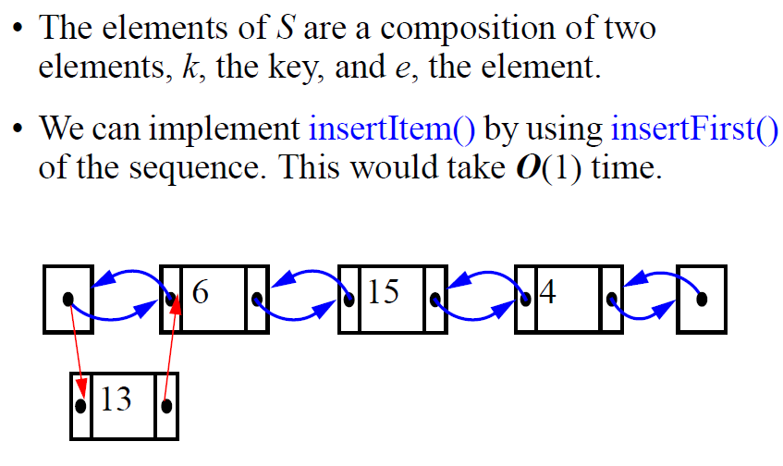
Priority Queues
Priority Queue: Implementation with an Unsorted Sequence
Computer Science, Purdue University

Slide 6
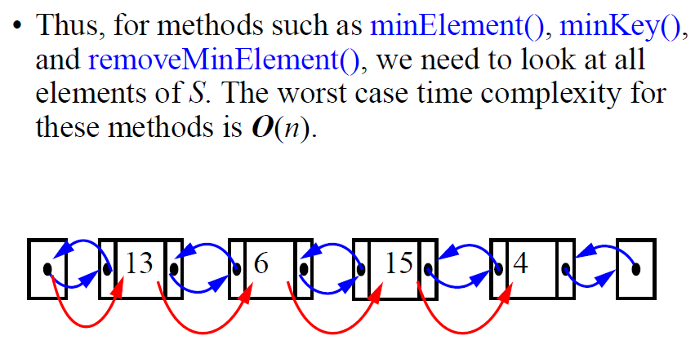
Priority Queues
Priority Queue: Implementation with an Unsorted Sequence
Computer Science, Purdue University

Slide 7
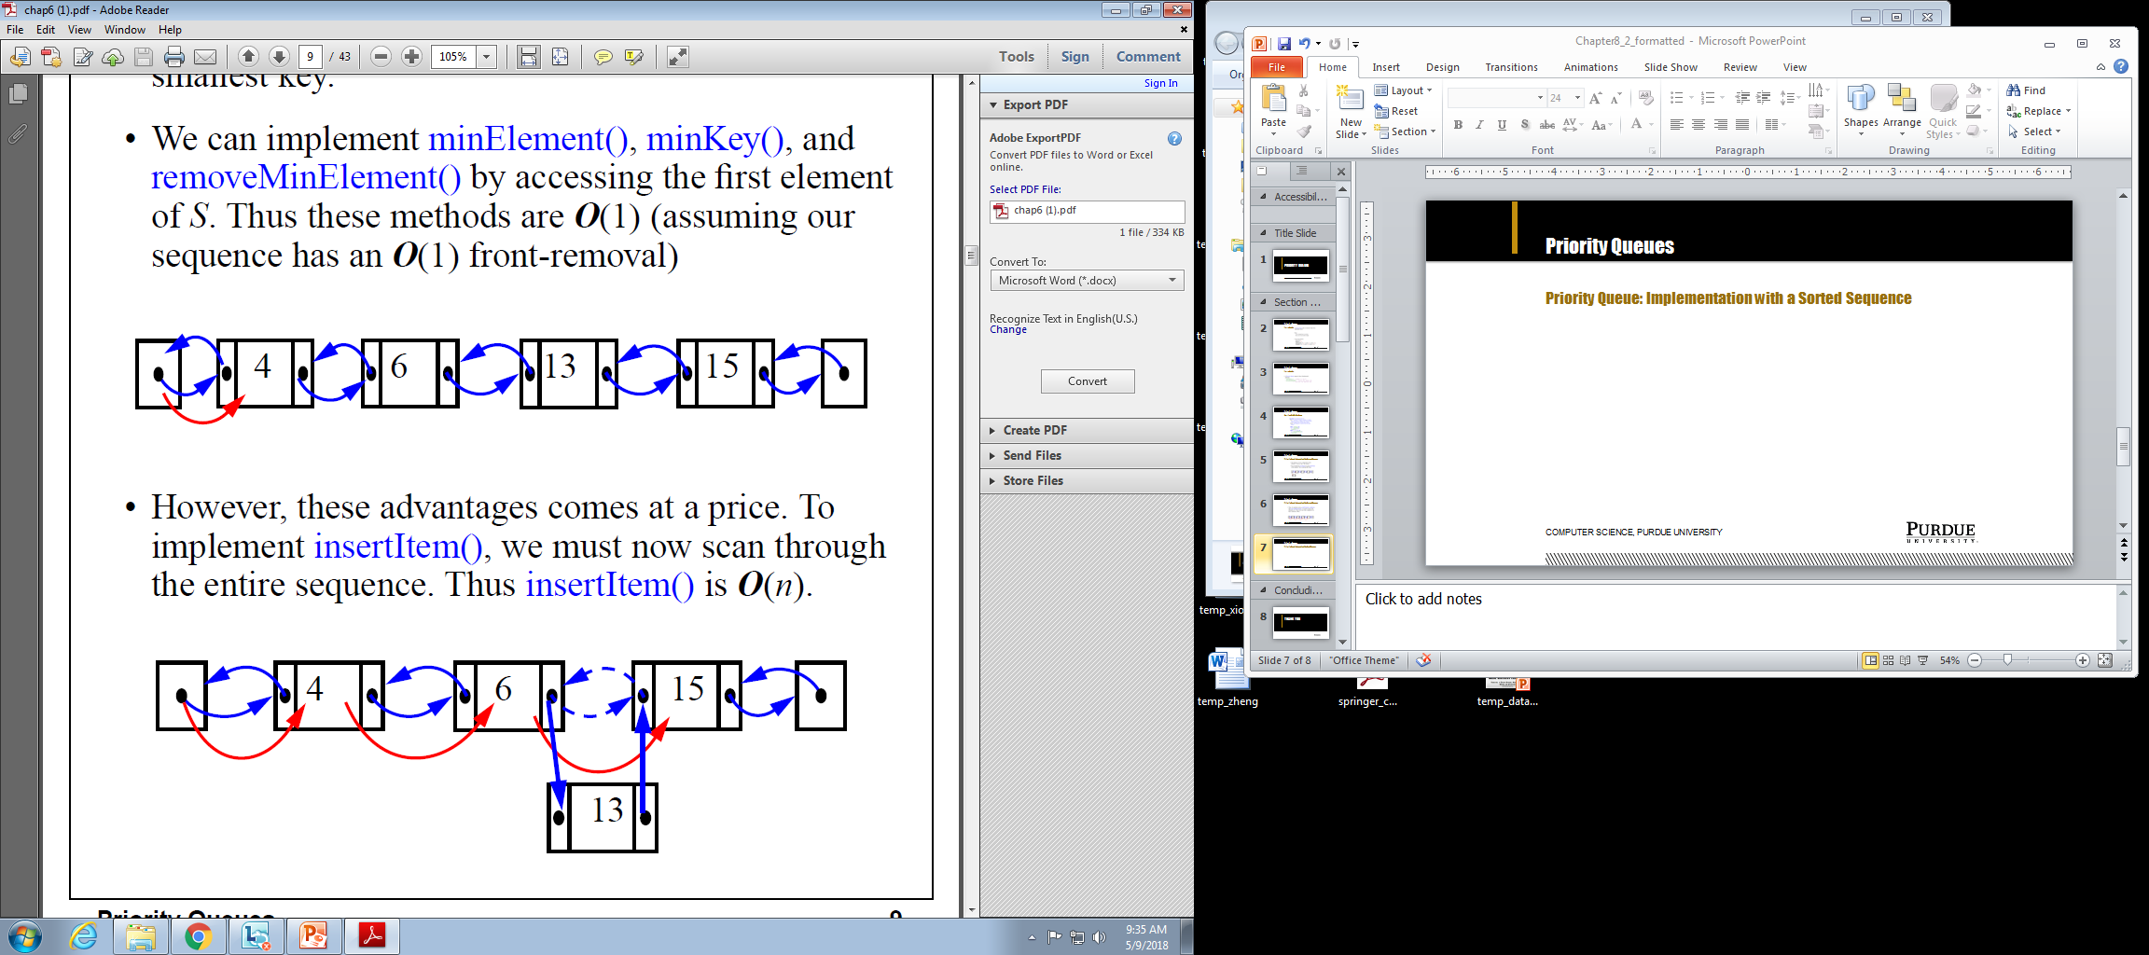
Priority Queues
Priority Queue: Implementation with a Sorted Sequence
Computer Science, Purdue University

Slide 8
Priority Queues
Priority Queue: Implementation with a Sorted Sequence
Computer Science, Purdue University

Slide 9
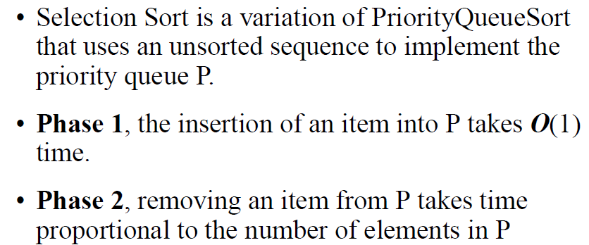
Priority Queues
Selection Sort
Computer Science, Purdue University

Slide 10
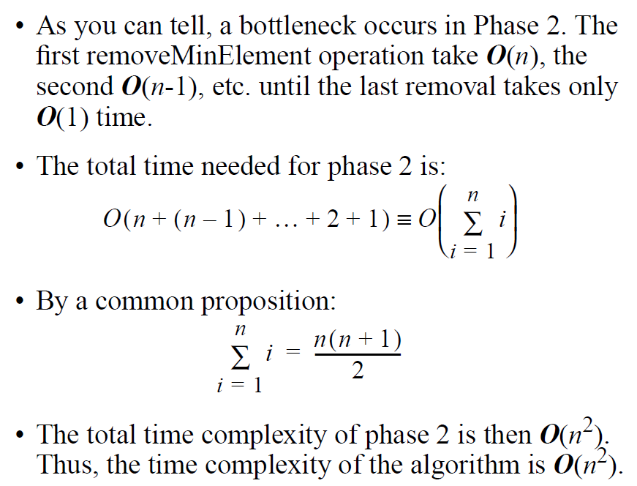
Priority Queues
Selection Sort
Computer Science, Purdue University

Slide 11
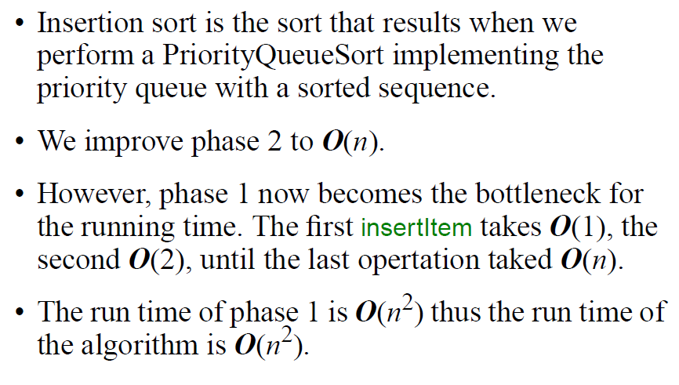
Priority Queues
Insertion Sort
Computer Science, Purdue University

Slide 12
Thank You

